Slide 1
1.4 JD+ on Github
ESTP Training
05-07 October 2026

Slide 2

https://github.com/jdemetra/

Slide 3
GitHub specifics
git web-based hosting
« Social coding »
Issue tracking
Pull request
Wiki

Slide 4
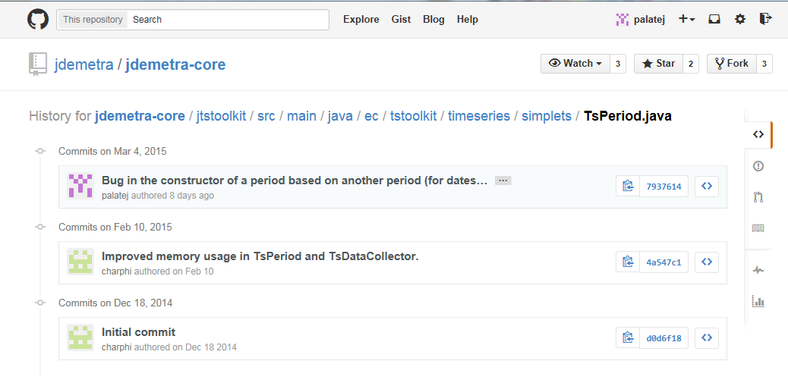
git web-based hosting
Git is a distributed revision control system with an emphasis on speed, data integrity, and support for distributed, non-linear workflows. [Wikipedia]

Slide 5
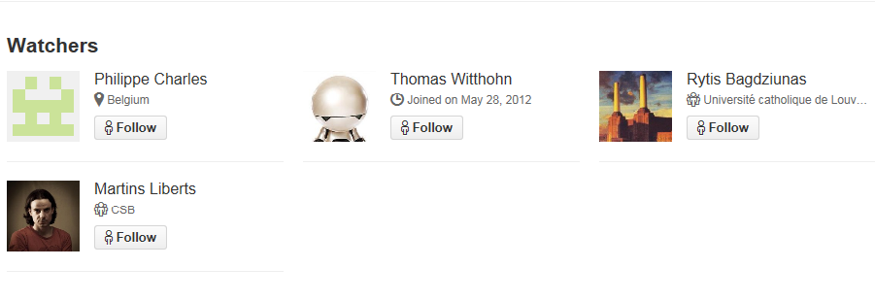
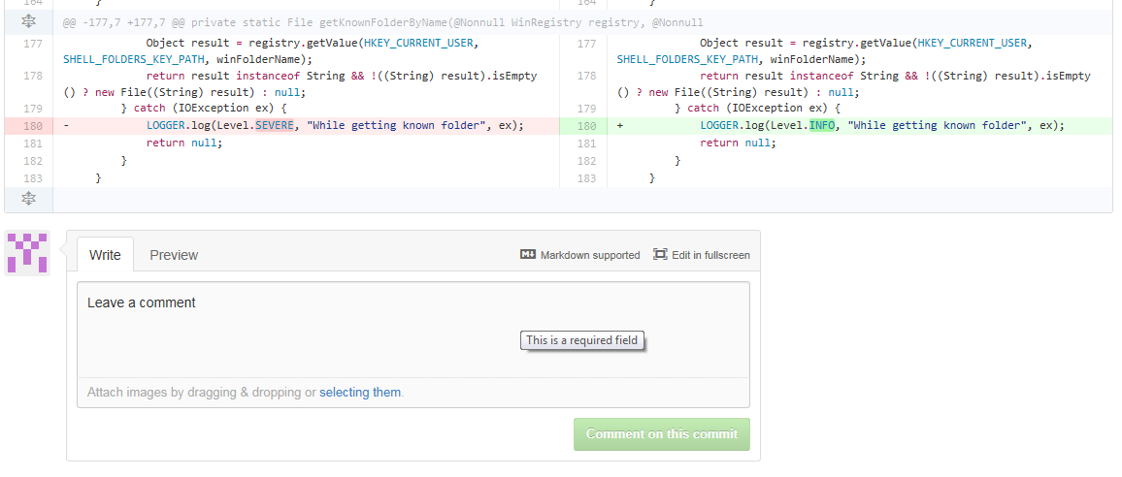
« Social coding »

Slide 6
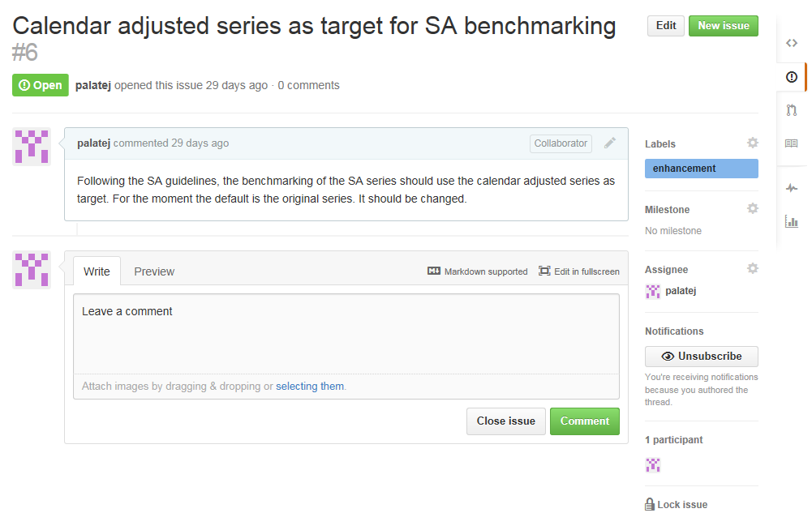
Issue tracking

Slide 7
Pull request
Main steps
  Create the feature in a dedicated branch in a local repository
  Push the branch to a public repository (on Github)
  Create a pull request (on Github)
  Review of the code, discussions, modifications bu the other developers
  The project maintainer merges the feature into the official repository and closes the pull request.
Remarks:
  “Social control” (everything is public)
  Final decision belongs to the owner of the project

Slide 8
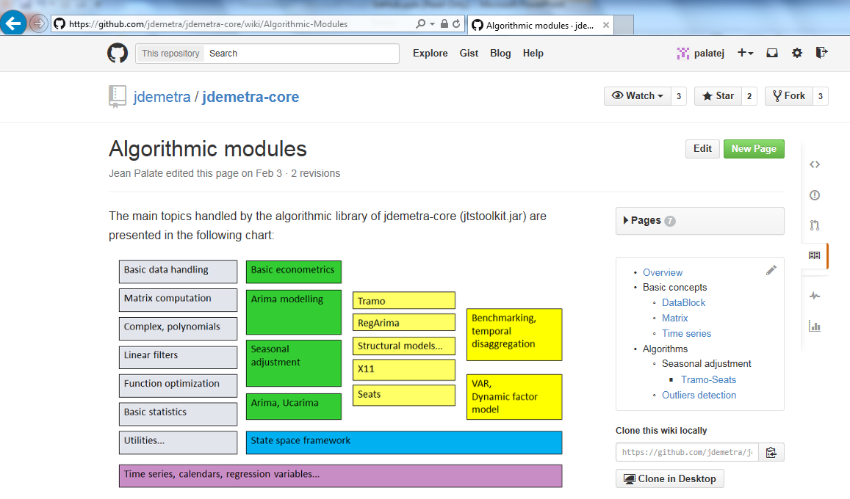
Wiki
Technical documentation on the use of the libraries

Slide 9
JDemetra resources on Github (and others)
Java libraries (including GUI/Cruncher)
  https://github.com/jdemetra
R packages
  https://github.com/rjdverse
Documentation
  https://doc.jdemetra.org/
  https://rjdverse.r-universe.dev/packages
Training
  https://github.com/palatej/estp2026

Slide 10
Final remarks
Powerful tool
  For distributed revision control
  For collaborative development
Mainly designed for developers!
  Complex tool (git)
  Focus on code
Wiki, issue tracking and follow up
  You could (should) contribute.
Migration to gitlab in the future ???

